Slide 1
SER 334 A Session
SI Session
Thursday, January 18th 2024
7:00 pm - 8:00 pm MST

Slide 2
{
Agenda
Pointer Tracing
Static and Heap Memory
Structs
Function Parameters
Macros

Slide 3
SI Session Expectations
Thanks for coming to the Enter course SI session. We have a packed agenda and we are going to try to get through as many of our planned example problems as possible. This session will be recorded and shared with others.
If after this you want to see additional examples, please visit the drop-in tutoring center.
We will post the link in the chat now and at the end of the session.
tutoring.asu.edu
Please keep in mind we are recording this session and it will be made available for you to review 24-48 hours after this session concludes.
Finally, please be respectful to each other during the session.

Slide 4

Interact with us:
Zoom Features
Zoom Chat
Use the chat feature to interact with the presenter and respond to presenter’s questions.
Annotations are encouraged

Slide 5
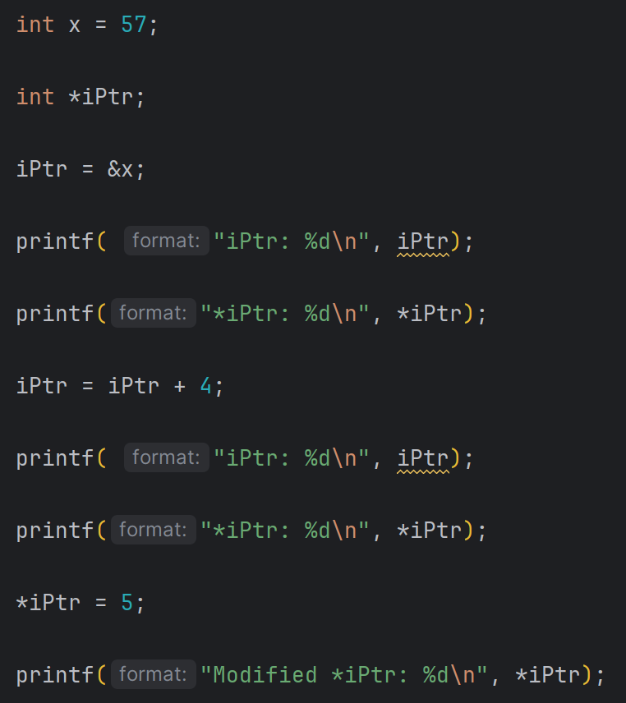
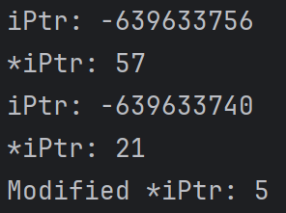
SER 334
Pointer Tracing
Pointer Tracing Practice

Slide 6
0x1110 | 57
0x1111 | NULL
0x1112 | K
0x1113 | a
0x1114 | t
0x1115 | i
0x1116 | e
0x1117 | \0
0x1118 | 99
0x1119 | 0x1118
0x1120 | 97
0x1121 | 0x1112
0x1122 | j
SER 334
Pointer Tracing
Pointer Tracing Practice
Prints:
Address
57

Slide 7
0x1110 | 57
0x1111 | NULL
0x1112 | K
0x1113 | a
0x1114 | t
0x1115 | i
0x1116 | e
0x1117 | \0
0x1118 | 99
0x1119 | 0x1118
0x1120 | 97
0x1121 | 0x1112
0x1122 | j
SER 334
Pointer Tracing
Pointer Tracing Practice
Prints:
Address
t

Slide 8
0x1110 | 57
0x1111 | NULL
0x1112 | K
0x1113 | a
0x1114 | t
0x1115 | i
0x1116 | e
0x1117 | \0
0x1118 | 99
0x1119 | 0x1118
0x1120 | 97
0x1121 | 0x1112
0x1122 | j
SER 334
Pointer Tracing
Pointer Tracing Practice
5
Prints:
t

Slide 9
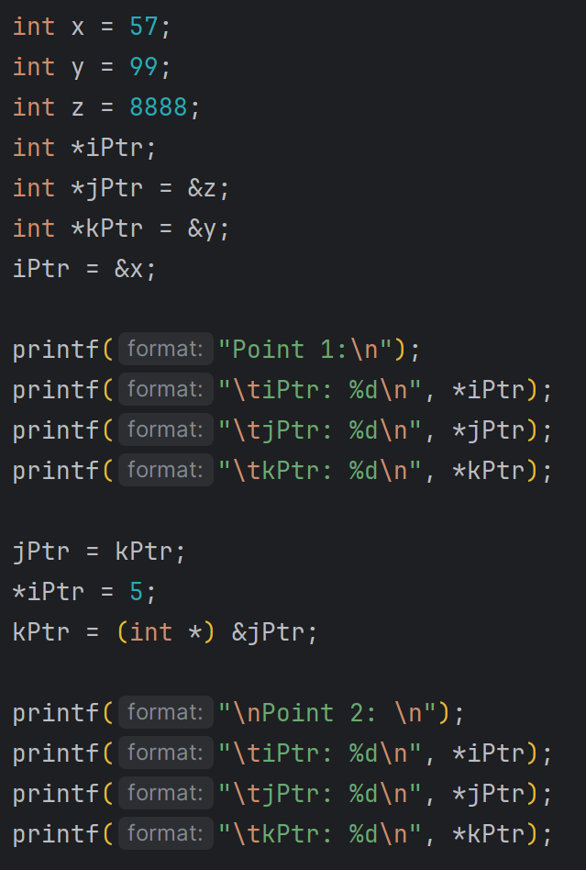
Trace the following code with box and arrow notation
SER 334
Pointer Tracing

Slide 10
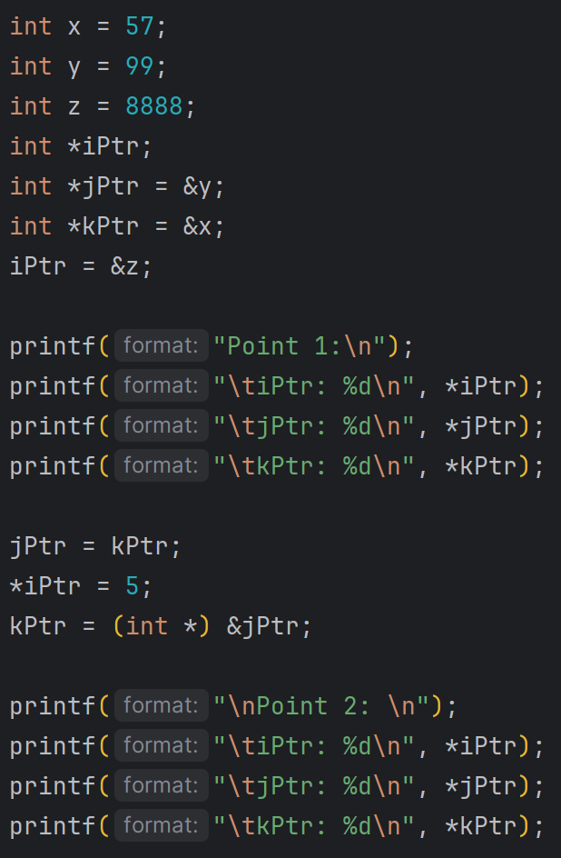
Trace the following code with box and arrow notation
SER 334
x
57
Pointer Tracing
y
99
z
8888
iPtr
jPtr
kPtr

Slide 11
Trace the following code with box and arrow notation
SER 334
x
57
Pointer Tracing
y
99
z
8888
5
iPtr
jPtr
kPtr

Slide 12
Memory
SER 334
Memory
Does anyone want to fill in the memory diagram from here?
Otherwise I can give some hints…

Slide 13
Memory
SER 334
Memory
Notes:
Blank if they want to do it themselves!

Slide 14
Contents:
Memory
SER 334
Stack
Memory
Text/Code
Heap
Global & Static Variables/Objects
Static Memory
Dynamic Memory
Stack Pointer
Heap Pointer

Slide 15
Contents:
Memory
SER 334
Stack
Memory
Text/Code
Heap
Global & Static Variables/Objects
Static Memory
Dynamic Memory
Stack Pointer
Heap Pointer

Slide 16
Contents:
Memory
SER 334
Stack
Text/Code
Memory
Text/Code
Static Memory
Global & Static Variables/Objects
Heap
Global & Static Variables/Objects
Which type of memory is deallocated when it passes out of scope?
Heap Pointer
Heap
Static Memory
Dynamic Memory
Dynamic Memory
Stack Pointer
Stack
Stack Pointer
Heap Pointer

Slide 17
Contents:
Memory
SER 334
Stack
Stack
Text/Code
Memory
Text/Code
Static Memory
Global & Static Variables/Objects
Heap
Global & Static Variables/Objects
Heap Pointer
Heap
Static Memory
Dynamic Memory
Dynamic Memory
$sp
Occupied
Stack Pointer
Stack
Stack Pointer
Heap Pointer

Slide 18
Contents:
Memory
SER 334
Stack
Stack
Stack
Text/Code
Memory
Text/Code
Static Memory
Global & Static Variables/Objects
Heap
Global & Static Variables/Objects
Heap Pointer
Heap
Static Memory
$sp
Dynamic Memory
Stack Frame
$fp
$sp
Dynamic Memory
Return Address
$sp
Occupied
Occupied
Stack Pointer
Stack
Stack Pointer
Heap Pointer

Slide 19
Contents:
Memory
SER 334
Stack
Text/Code
Memory
Text/Code
Static Memory
Global & Static Variables/Objects
Heap
Global & Static Variables/Objects
What about dynamic/run-time memory allocation?
Heap Pointer
Heap
Static Memory
Dynamic Memory
Dynamic Memory
Stack Pointer
Stack
Stack Pointer
Heap Pointer

Slide 20
Contents:
Memory
SER 334
Stack
Text/Code
Memory
Text/Code
Static Memory
Global & Static Variables/Objects
Heap
Global & Static Variables/Objects
What about dynamic/run-time memory allocation?
What’s different with heap memory?
Heap Pointer
Heap
Static Memory
Dynamic Memory
Dynamic Memory
Stack Pointer
Stack
Stack Pointer
Heap Pointer

Slide 21
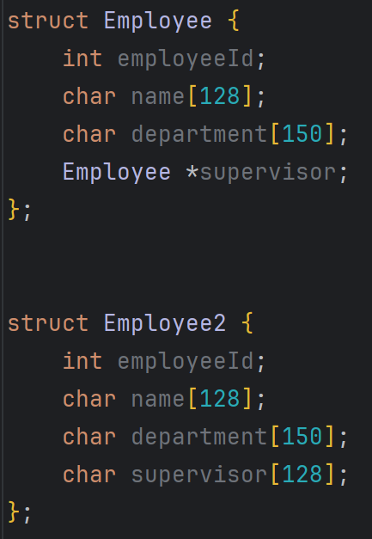
Which structure uses more memory?
SER 334
Structs

Slide 22
Which structure uses more memory?
SER 334
296
Structs
4
128
150
8
2
412
4
128
150
128
2
Notes:
after the sizing breakdown, ask which is more efficient/better for use
the answer is it depends on usage - if we want to be able to access the super, then probably the first one

Slide 23
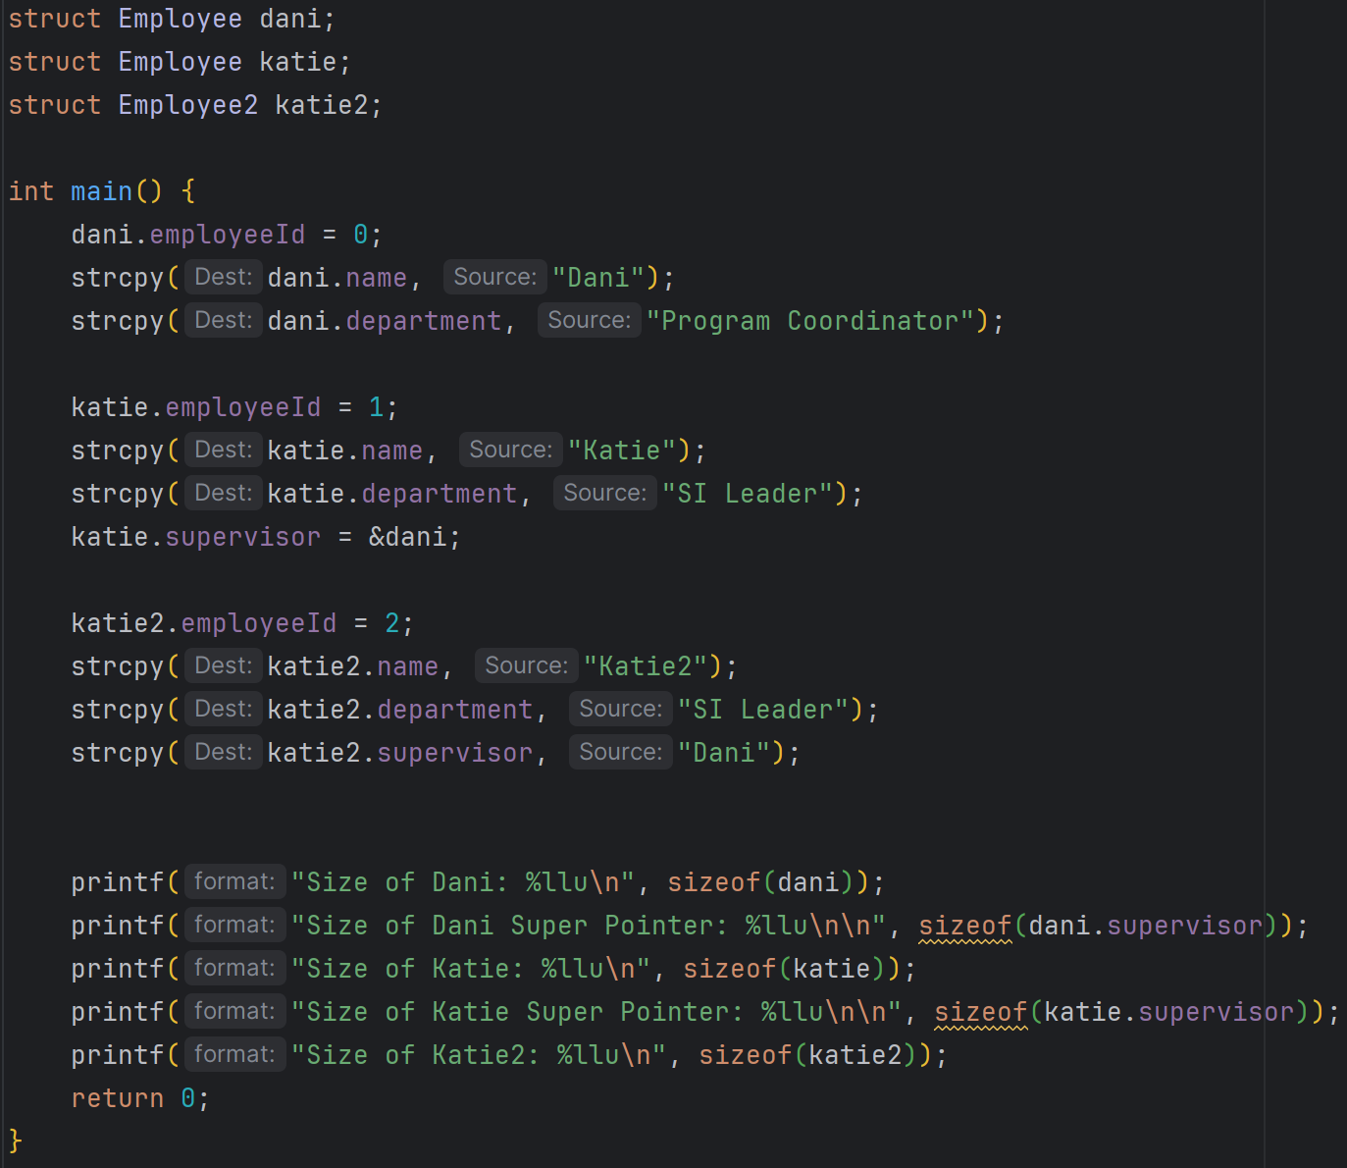
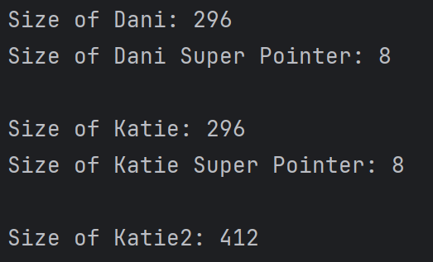
Is this okay?
What size will print?
What about this one?
SER 334
Structs
296
412

Slide 24
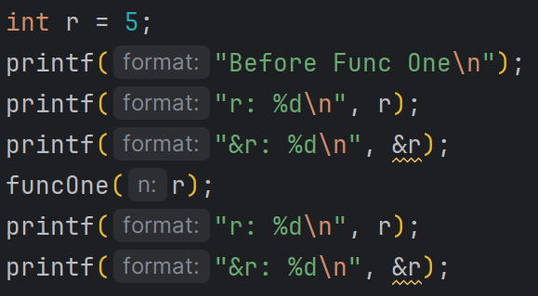
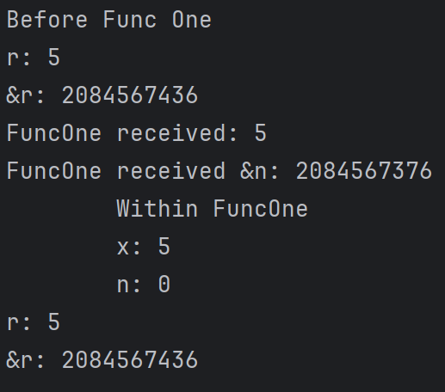
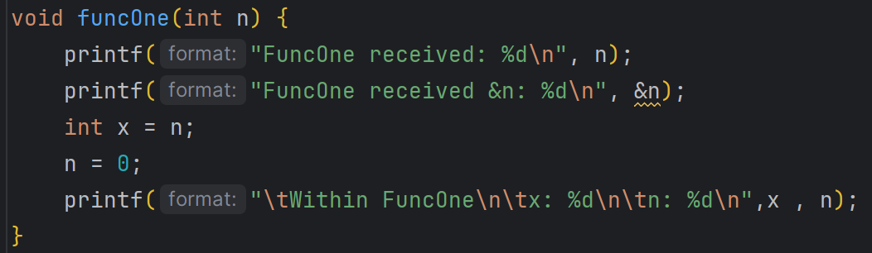
SER 334
Parameters
Standard Pass-By-Value, same as we have before.
Notes:
Same or different?? - different bc we make a copy
5 or zero?? - 5 bc we only updated the copy

Slide 25
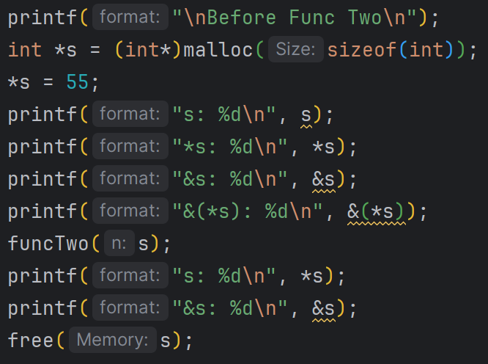
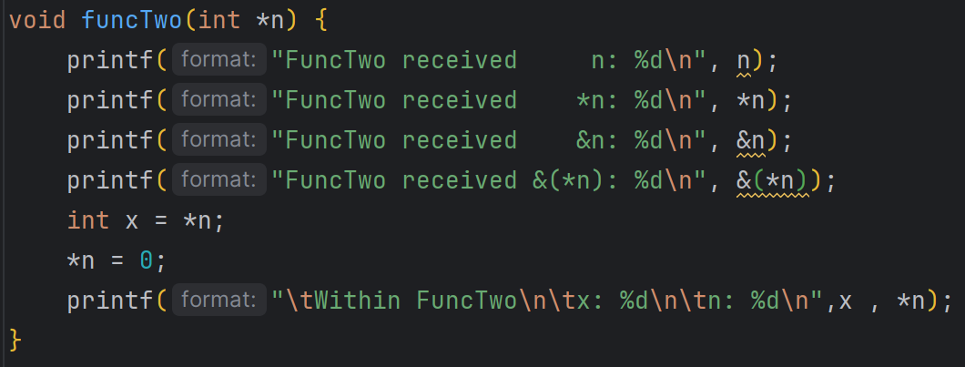
0x#
55
SER 334
Parameters
0x##
s
0x#
Pass-By-Value, using a pointer.
Notes:
First - what are we missing??

Slide 26
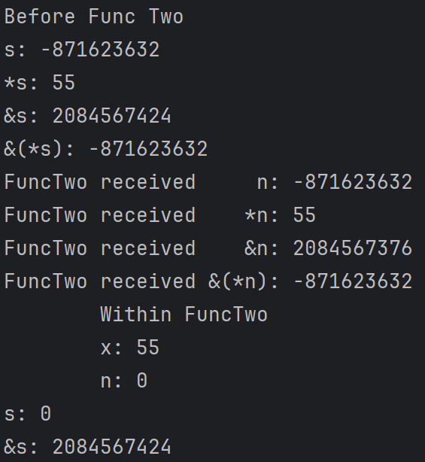
SER 334
Parameters
Pass-By-Value, using a pointer.
Notes:
First - what are we missing??

Slide 27
0x#
55
SER 334
Parameters
0x##
s
0x#
Pass-By-Value, using a pointer.
Notes:
First - what are we missing??

Slide 28
0x3632
55
SER 334
Parameters
0x7424
s
0x3632
Pass-By-Value, using a pointer.
Notes:
First - what are we missing??

Slide 29
0x3632
55
SER 334
Parameters
0x7424
s
0x3632
0x7424
n
0x3632
Pass-By-Value, using a pointer.
Notes:
First - what are we missing??

Slide 30
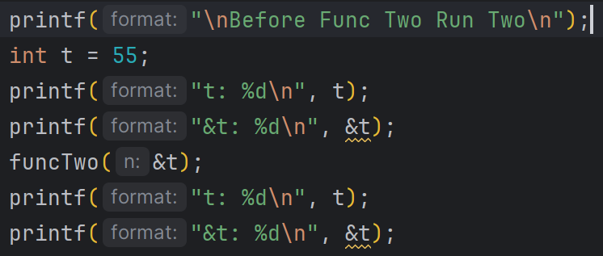
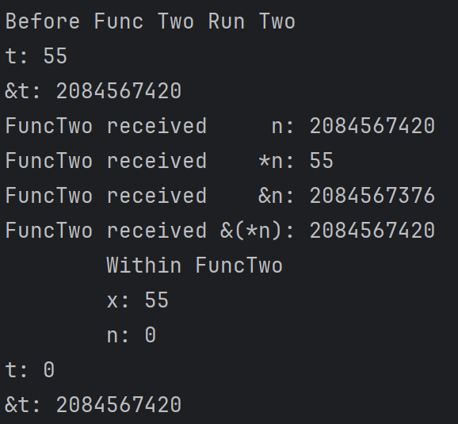
SER 334
Parameters
Sent the location of the variable!
Pass-By-Reference
Notes:
Why pass by reference?

Slide 31
SER 334
Parameters
Sent the location of the variable!
0x7420
t
55
Notes:
Why pass by reference?

Slide 32
SER 334
Parameters
Sent the location of the variable!
0x7420
t
55
0x7420
n
55
Notes:
Why pass by reference?

Slide 33
SER 334
Parameters
Sent the location of the variable!
0x7420
t
55
0x7420
n
55
Notes:
Why pass by reference?

Slide 34
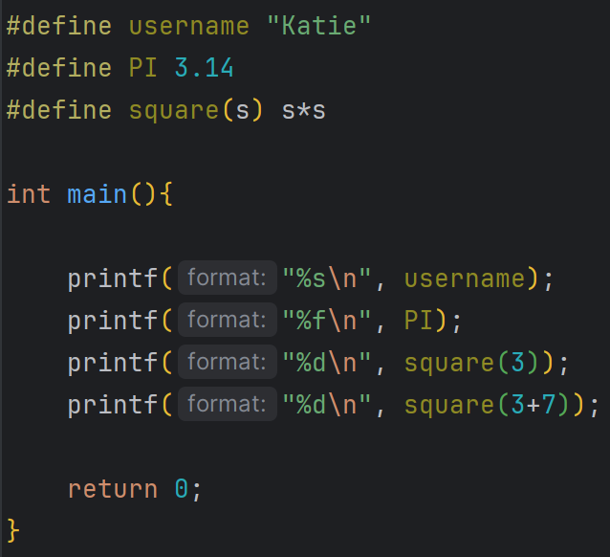
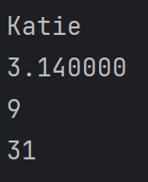
Very helpful BUT we need to be careful
SER 334
Macros
?
Notes:
Why?
Direct substitution!

Slide 35
Upcoming Events
SI Sessions:
Sunday, January 21st at 7:00 pm MST
Monday, January 22nd at 7:00 pm MST
Sunday, January 28th at 7:00 pm MST Cancelled - good luck on Exam 1!
Monday, January 29th at 7:00 pm MST
Review Sessions:
Exam 1 Review: Thursday, January 25th 7:00 pm - 9:00 pm MST

Slide 36

Questions?
Survey:
http://bit.ly/ASN2324

Slide 37


More Questions?
Check out our other resources!
tutoring.asu.edu
1-
2-
Click on ‘Go to Zoom’ to log onto our Online Tutoring Center.
Click on ‘View the tutoring schedule’ to see when tutors are available for specific courses.

Slide 38
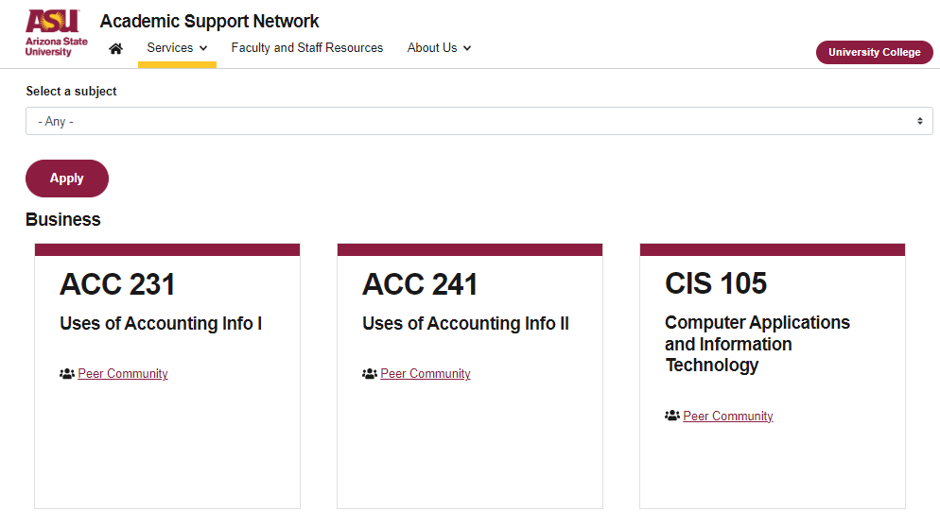

More Questions?
Check out our other resources!
tutoring.asu.edu/online-study-hub
Don’t forget to check out the Online Study Hub for additional resources!

Slide 39
Additional Resources
Course Repo
BMP File Format (Wiki)
Linux Kernel API

